Slide 1
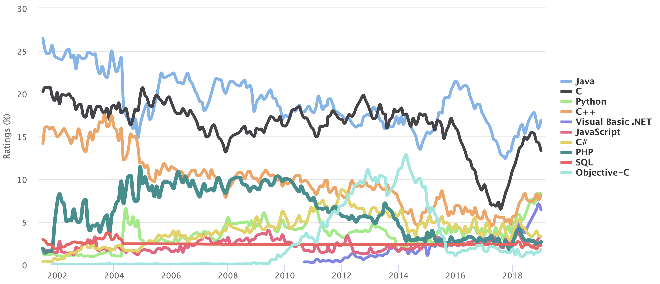
UC Berkeley’s CS61A – Lecture 01 – Functions
Computing
in the news
Python is TIOBE's programming language of the year 2018! www.tiobe.com/tiobe-index
“The Python programming language has won the title "programming language of the year"! Python has received this title because it has gained most ranking points in 2018 if compared to all other languages. The Python language has won 3.62%, followed by Visual Basic .NET and Java. Python has now definitely become part of the big programming languages. For almost 20 years, C, C++ and Java are consistently in the top 3, far ahead of the rest of the pack. Python is joining these 3 languages now. It is the most frequently taught first language at universities nowadays, it is number one in the statistical domain, number one in AI programming, number one in scripting and number one in writing system tests. Besides this, Python is also leading in web programming and scientific computing (just to name some other domains).” In summary, Python is everywhere.

Slide 2
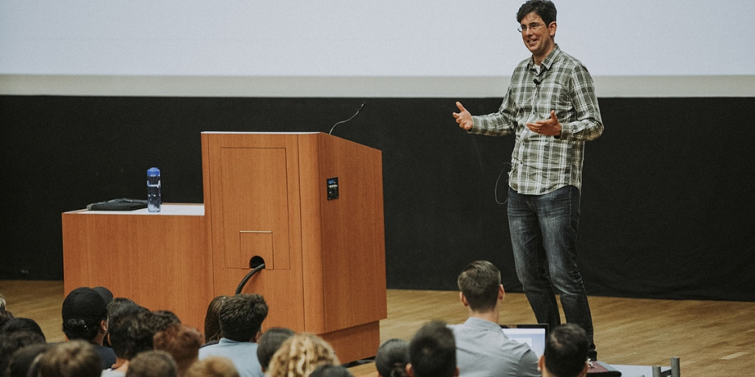
I stand on the shoulders of giants, literally!
John Denero and a superstar team of TAs helped build this course to what it is, transitioning the course from Scheme to Python but preserving all that made it great!
Was awarded the campus Distinguished Teaching Award for it!

Slide 3
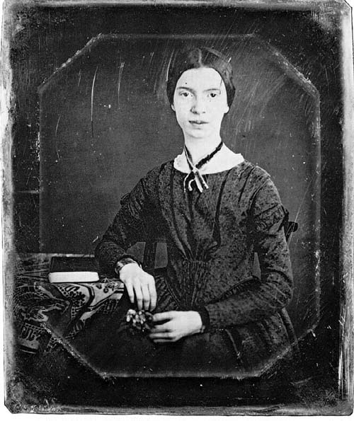
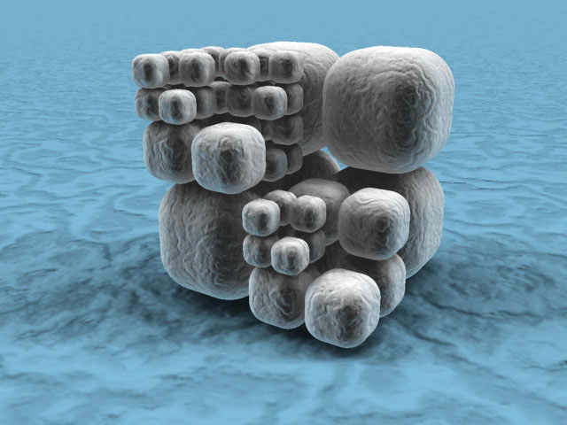

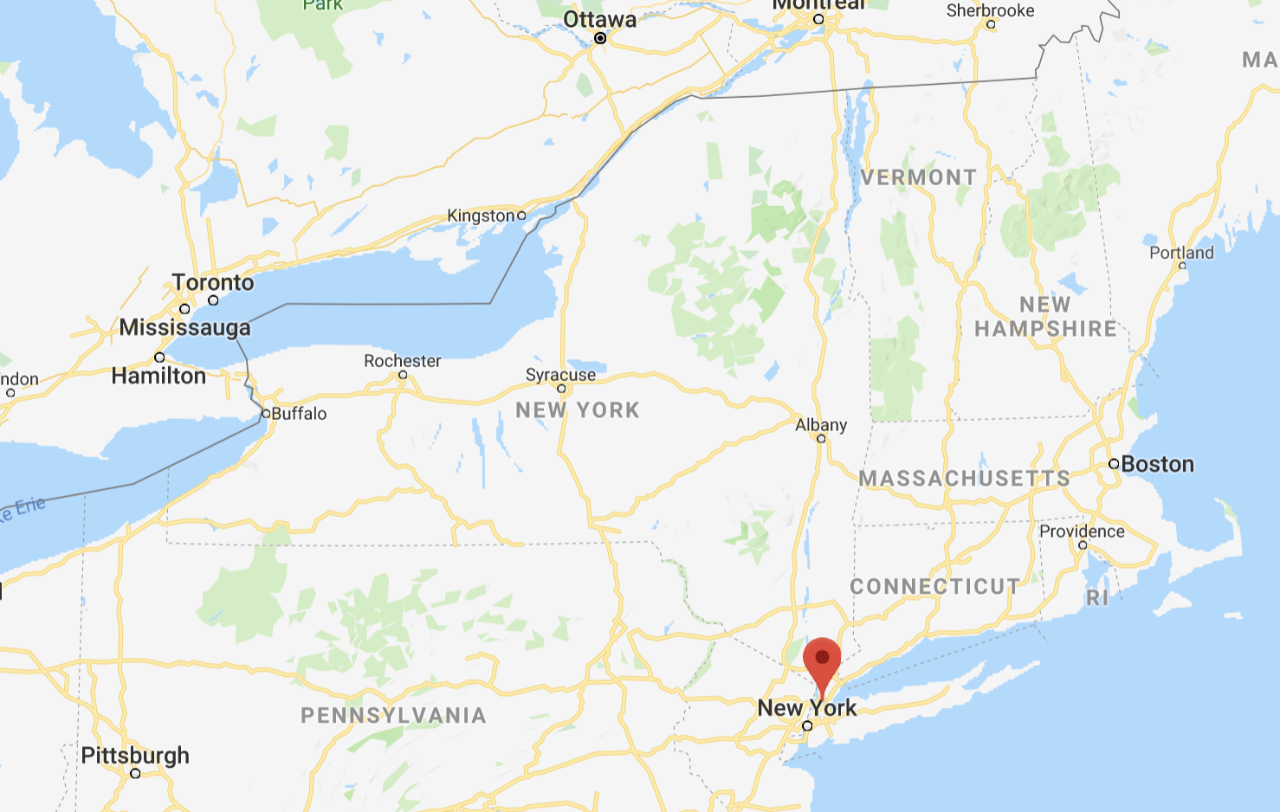

Welcome to CS 61A!
Dan Garcia
ddgarcia@berkeley.edu
Office hours in 777 Soda:
11am-noon Friday …or by appt
Fastest way to get answers: piazza.com/berkeley/spring2019/cs61a
Contact Head TAs: cs61a@berkeley.edu

Slide 4
The 61A Community
49 teaching assistants (TAs), formally known at Berkeley as GSIs or UGSIs:
Teach lab & discussion sections
Hold drop-in office hours
Lots of other stuff: develop assignments, grade exams, etc.
49 mentors/tutors:
Teach mentoring sections
Hold drop-in office hours
Lots of other stuff: homework parties, mastery sections, etc.
250+ academic interns help answer individual questions & check your progress
1,250+ fellow students make CS 61A unique

Slide 5
Parts of the Course
Lecture: Each live lecture will be filmed and put online a few hrs after – watch that day!
Lab section: The most important part of this course (next week)
Discussion section: The most important part of this course (this week)
Staff office hours: The most important part of this course (next week)
Online textbook: http://composingprograms.com
Weekly homework assignments, three exams, & four programming projects
Lots of optional special events to help you complete all this work
Everything is posted to cs61a.org

Slide 6
An Introduction to Computer Science

Slide 7
What is Computer Science?
What problems can be solved using computation,
How to solve those problems, and
What techniques lead to effective solutions
The study of
Creativity!
Systems
Artificial Intelligence
Graphics
Security
Networking
Programming Languages
Theory
Scientific Computing
...
Decision Making
Robotics
Natural Language Processing
...
Answering Questions
Translation
...

Slide 8


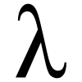
What is This Course About?
A course about managing complexity
Mastering abstraction
Programming paradigms
An introduction to programming
Full understanding of Python fundamentals
Combining multiple ideas in large projects
How computers interpret programming languages
Different types of languages: Scheme & SQL
A challenging course that will demand a lot of you
Hard
Fun

Slide 9
Alternatives to CS 61A

Slide 10


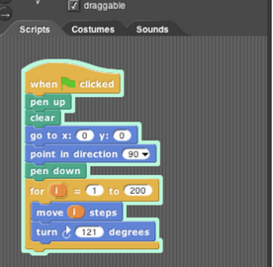
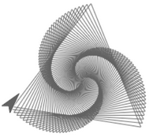
CS 10: The Beauty and Joy of Computing
Designed for students without prior experience
A programming environment created by Berkeley, now used in courses around the world and online
An introduction to fundamentals (& Python) that sets students up for success in CS 61A
Spring 2019: Dan Garcia
100+ seats available
More info: http://cs10.org/
If you have no experience, we STRONGLY encourage you to enroll in both classes, then after the first exams for each classes on 2/11, decide which one you want and drop the other one.

Slide 11
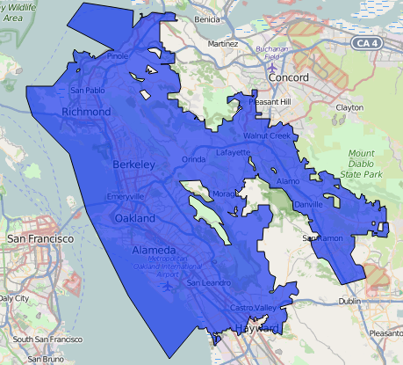
Data Science 8: Foundations of Data Science
Fundamentals of computing, statistical inference, & machine learning applied to real-world data sets
More statistics than computer science
Great programming practice for CS 61A
Listed as CS C8
147+ person waitlist
More info: http://data8.org/

Slide 12
Course Policies

Slide 13
Course Policies
Uncool
Cool
You don’t know that? Sheesh! (rolls eyes)
Elitism
“Me first” attitude
Making students feel unwelcome
You having trouble? Here, let me help!
Supporting each other
“We together” attitude
Making students feel welcome. We are a CS61A family!
Learning
Community
Course Staff
Details...
http://cs61a.org/articles/about.html

Slide 14
Collaboration
Asking questions is highly encouraged
Discuss everything with each other; learn from your fellow students!
Some projects can be completed with a partner
Choose a partner from your discussion section
The limits of collaboration
One simple rule: Don’t share your code, except with your project partner
Copying project solutions causes people to fail the course
We really do catch people who violate the rules, because...
We also know how to search the web for solutions
We use computers to check your work
Build good habits now

Slide 15
Innovations brought from CS10 to CS61A
Computing in the News
We’ll bring relevant social implications of computing topics into the course!
Three slip days for projects (not for homework, which are graded on effort)
You have three slip day “virtual tokens” used to give you more time for projects. Use them all at once to extend a deadline by 3 days, or meter them out per project
We will provide you with EPA = Effort, Participation, Altruism extra credit (confidential)
Effort = {Office hours, doing every single lab, hw, reading Piazza pages, etc.}
Participation = {Raising hand in discussion, asking Piazza questions, etc.}
Altruism = {Helping other students in lab, answering Piazza or Office Hrs questions}
This can help boost you over a grade boundary if you’re close to one
Peer instruction in lecture
Not required for EPA; no clickers needed; google form online questions on phone/laptop
Handouts
If you want them take them. If you don’t, please don’t (and we’ll make fewer copies later)
You will be able to clobber your midterms with a better performance on your final
If your % of points on your final is higher than either midterm, we map that % to your midterm and that’s your new midterm! E.g., Final 50/100, Midterm 10/40. New midterm:20/40

Slide 16
Announcements
Discussion this week
Lab next week
You don’t have to come to lecture, Friday and onward there will only be 1 lecture 2-3pm, so 500/1250 of you have to decide to watch the webcast only. We can’t have anyone in the aisles per fire marshall rules.
Take CS10 concurrently if you don’t have any programming experience
Don’t take a handout if you won’t use it, write on it, keep it.

Slide 17
Expressions

Slide 18
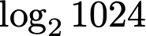
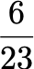
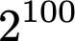
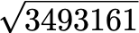
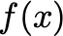
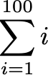
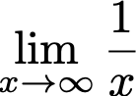
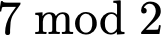
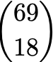
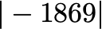
Types of expressions
An expression describes a computation and evaluates to a value

Slide 19
Call Expressions in Python
All expressions can use function call notation
(Demo)

Slide 20
Anatomy of a Call Expression
add ( 2 , 3 )
Operator
Operand
Operand
Operators and operands are also expressions
So they evaluate to values
Evaluation procedure for call expressions:
Evaluate the operator and then the operand subexpressions
Apply the function that is the value of the operator to the arguments that are the values of the operands

Slide 21
Evaluating Nested Expressions
224
mul(add(4, mul(4, 6)), add(3, 5))
mul
28
8
add(4, mul(4, 6))
add(3, 5)
add
4
24
add
3
5
mul(4, 6)
mul
4
6

Slide 22
Evaluating Nested Expressions
Operand subexpression
Value of the whole expression
224
mul(add(4, mul(4, 6)), add(3, 5))
Value of subexpression
1st argument to mul
mul
28
8
add(4, mul(4, 6))
add(3, 5)
add
4
24
add
3
5
mul(4, 6)
mul
4
6
Expression tree

Slide 23
Functions, Values, Objects, Interpreters, and Data
(Demo)

